Slide 1
Database System
CL 203
Lab 01
Introduction and Basics

Slide 2
Who Am I?

Slide 3
Tentative Grading Scheme (May Vary)
Lab Activities 30%
Lab Quizzes 10%
Project 10%
Lab Mid 20%
Lab Final Exam 30%

Slide 4
Contacting me
Email:
ammara.yaseen@nu.edu.pk Section: D, F and G
Mahrukh.khan@nu.edu.pk Section: B and E
Basit.jasani@nu.edu.pk Section: A and C
Room: PHD Room (Next to Room 109)

Slide 5
Introduction
Lets get to know you people one by one…
Name
Your area of interests?
What you want to be in future?
Computer Science why?
What unique you can do through Computer Science?

Slide 6
Any Idea??
Conventional Data saving in ancient times?
What is a Database?
What is DBMS?
Name some DBMSs?
Why is Database used?

Slide 7
DATABASE
“Collection of inter-related data in an organized manner”
DBMS
“A program that manages Database”

Slide 8
Role of DBMS
STORES
DBMS
Eg. Sql Server,Oracke,My sql,DB2
DB
RETREIVES
MODIFIES

Slide 9
RDB
What is a Relational Database?
“Collection of relations (tables) or 2-dimensional Tables”

Slide 10
Key Points
A table is a basic storage structure unit of an RDBMS
Easy to use
Flexible in structure
Security and Authorization methods are well defined
Protect Data integrity
Can be accessed and modifies by executing structured query language statements
Uses a set of relational Operators(Selection,Join) and a set operation Union, Intersection etc
Contains a collection of tables with No Physical Pointers as we use Primary Key & Foreign Key to access and relate data
Keeps logical representation of data independent of its physical storage characteristics

Slide 11
Sl.# | DBMS | RDBMS
1 | Introduced in 1960s. | Introduced in 1970s.
2 | During introduction it followed the navigational modes (Navigational DBMS) for data storage and fetching. | This model uses relationship between tables using primary keys, foreign keys and indexes.
3 | Data fetching is slower for complex and large amount of data. | Comparatively faster because of its relational model.
4 | Used for applications using small amount of data. | Used for complex and large amount of data.
5 | Data Redundancy is common in this model | Keys and indexes are used in the tables to avoid redundancy.
6 | Example systems are dBase, Microsoft Acces, LibreOffice Base, FoxPro. | Example systems are SQL Server, Oracle, MySQL, MariaDB, SQLite

Slide 12
Schema
Set of Relational Tables in a DB
Table: Basic Unit of storage composed of Rows and Columns
Columns represent attributes of an entity
Rows represent tuple or a record
In RDB a Table representing one entity is called a relation and the connection between 2 different tables is a relationship

Slide 13
What is SQL?
Special Purpose Programming Language designed to work upon and manage the data held in RDBMS

Slide 14

In most RDBMS, SQL is used as a language interpreter
SQL
RDBMS
DB
User Tells
“What to do” in form of Query Language such as SQL
SQL interprets commands & queries to make them Understandable
RDBMS retrieves/modify Data as per Requested by the user

Slide 15
SQL (Continued..)
It is a non-procedural Language i.e. User Only tell “What To Do” not “How To Do”
SQL is used for:
Data Manipulation
Data Definition
Data Administration
All are expressed as an SQL statement or command.

Slide 16
PL/SQL
An Oracle Procedural Language which extends SQL by adding application logic

Slide 17
SQL Categories/Classification
DQL: Data Query Language
Select
DML: Data Manipulation Language
Insert, Update, Delete…
DDL: Data Definition Language
Create, Alter, Drop, Truncate, Rename
DCL: Data Control Language
Grant, Revoke
Transaction Control
Commit, Roll Back, Check Point

Slide 18
SQL (DQL) Syntax
Demobld: Create demo schema
Demodrop: Delete demo schema
Select:
Select [Column Name] from [Table Name] Selects a particular column data from a table
Select * from [Table Name] Selects all records from a table in a database
Select with Where clause: Limits the selected rows
Select [column name] from [table name] where [condition]

Slide 19
Null Values
Null is a value that is unavailable, unassigned, inappropriate, inapplicable, or unknown
A null is not the same as zero or blank

Slide 20
Conditions in SQL
Between: Between two values
AND: Both values should be true
In (SET): Among a set of values
Like: Like a character pattern
Is Null: is a null value

Slide 21
Arithmetic Precedence
*, /, +, -
Same priority evaluated from left to right

Slide 22
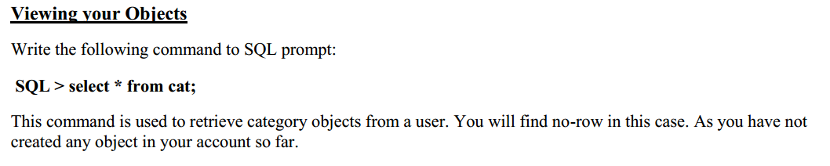

Slide 23
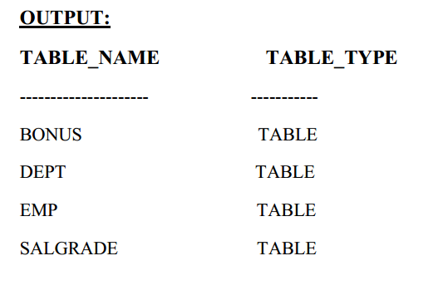

Slide 24
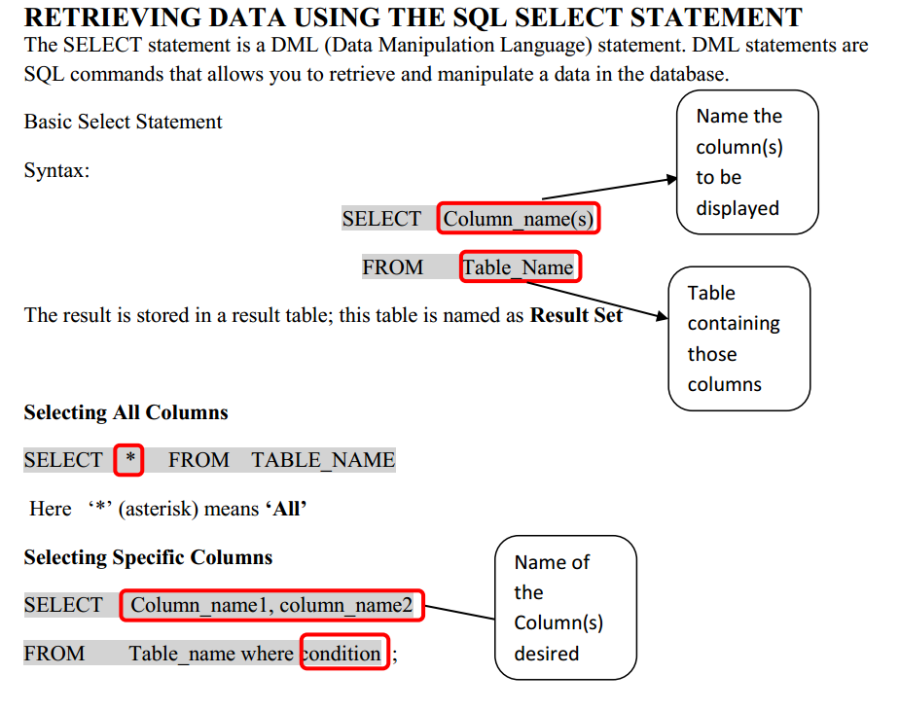

Slide 25
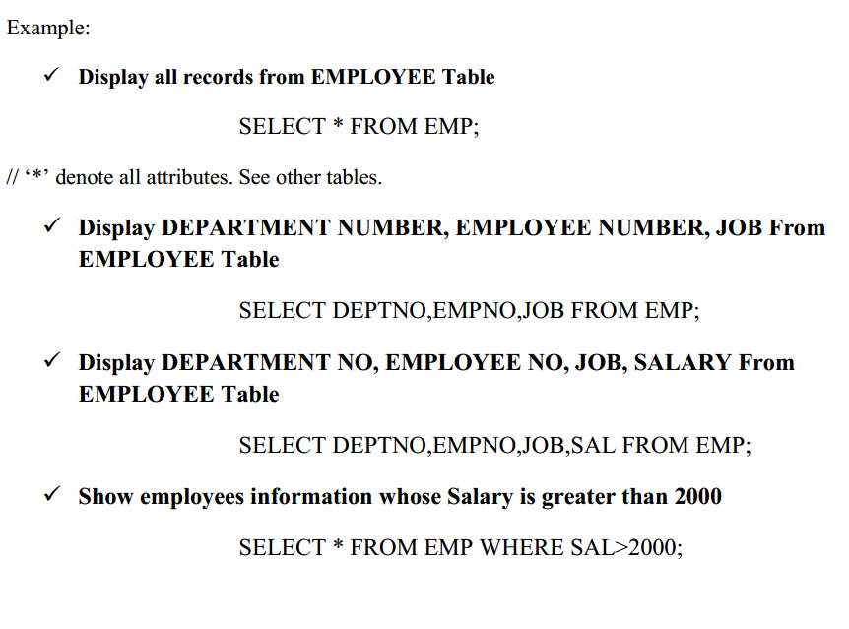

Slide 26
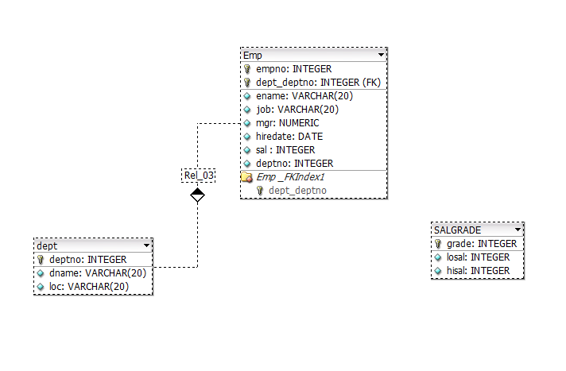
Simple Schema

Slide 27
Schema
EMP (empno, ename, job, mgr, hiredate, sal, deptno)
DEPT (deptno, dname, loc)
SALGRADE (grade, losal, hisal)

Slide 28
Step 1
Retrieve all rows & columns from the emp table.
SELECT * FROM emp;
// ‘*’ denote all attributes. See other tables.

Slide 29
Step 2
The columns to be selected from a table are specified after the keyword SELECT.
SELECT empno, ename, sal FROM emp;

Slide 30
Step 3
The SELECT clause may also contain arithmetic expression, e.g.
SELECT ename, deptno, sal * 2 FROM emp;

Slide 31
Step 4
Keyword DISTINCT forces elimination of duplicates from the query result.
SELECT DISTINCT job FROM emp;

Slide 32
Step 5
To sort the result ORDER BY clause is used. It takes one or more attributes listed in the SELECT clause. Asc specifies ascending order (default order) and desc specifies descending order.
SELECT ename, deptno, hiredate FROM emp
ORDER BY deptno asc;

Slide 33
Step 6
To select tuples that satisfy certain condition, WHERE clause is used. WHERE clause condition contains logical expressions connected by and, or and not to form complex conditions. Conditions may also include pattern matching and subqueries.
List name, job title and the salary of those employees whose manager has the number 7698 or 7566 and who earn more than 1500.
SELECT ename, job, sal FROM emp
WHERE (mgr = 7698 or mgr = 7566) and sal > 1500

Slide 34
Step 7
List name, job and hiredate of employees working in department number 20 or 30.
SELECT ename, job, hiredate FROM emp
WHERE deptno IN (20,30);
BONUS QUESTION: ( 1 mark )
Can you write it in another way, considering the step 6 example?

Slide 35
Step 8
List the emp_no and name of employee who has no manager.
SELECT empno, ename FROM emp
WHERE mgr IS NULL;

Slide 36
Step 9
List emp_no, name and job of employees whose salary is between 1500 – 2500
SELECT empno, ename, job FROM emp
WHERE sal BETWEEN 1500 AND 2500;
BONUS QUESTION: ( 1 mark )
Can you write it in another way?

Slide 37
Step 10
In string comparison surround the string by apostrophes. List employees name and salary of those employees working in department located in DALLAS.
SELECT ename, sal
FROM emp e, dept d
WHERE e.deptno = d.deptno AND d.loc = ‘DALLAS’;

Slide 38
Step 11
For pattern matching like operator is used. Two special characters are used: the percent sign (%) and under score (_). Percent sign means that any string is allowed there, while under score stands for exactly one character. Find name and job of employees whose name contain substring ‘LL’.
SELECT ename FROM emp
WHERE ename like ‘%LL%’;

Slide 39
Step 12
Aggregate functions return a single value for a set of column values. Count the number of employees.
SELECT count(*) as Total_Employees FROM emp;

Slide 40
Step 13
Following query displays employees names, dept number and location. Look how join works.
SELECT e.ename, e.deptno, d.deptno, d.loc
FROM emp e, dept d
WHERE e.deptno = d.deptno;

Slide 41
Exercises:
Display the name, job, and salary for all employees whose job is Clerk or Analyst and their salary are not equal to Rs.1000, Rs.3000, or Rs.5000. Display in descending order of salary. (4 rows)
Calculate the average salary of all the employees. (2073.21429)
List all the employees names, their department numbers and hire date with ascending order of dept numbers and descending order of hire date within a particular dept. (multiple columns in ORDER BY clause).
Find emp_no, name, salary and hire date of the employees who were hired in the first half year of 1981. Sort the output in ascending order of hiredate.
List name of employees along with name of their departments. Sort by department name.
How many different job titles are stored in the relation emp? (5)
List the minimum and maximum salary in relation emp. (800, 5000)
Sum all the salaries of employees working in the SALES department. (9400)
Compute the difference between the minimum and maximum salary. (4200)
List all employees whose name contains A in the third position. (3 names)
How many employees earn more than Rs. 2000. (6 emps)
Find total number of salesman and the sum of their salaries. (14, 29025)
List name of all employees along with the NAMES of their managers. (13 rows)

Slide 42
References:
Operators and functions available in Oracle:
For numbers: abs, cos, sin, exp, log, power, mod, sqrt, +, -, *, /,……..
For strings: concat( str1, str2 ), lower(column/expr), upper(column/expr), replace(str, search_str, replacement_str), concat(column1/expr1, column2/expr2), substr(str, m, n), length(column/expr), initcap(column/expr), …..
For dates: add_months(date,n), month_between(date1, date2), next_day(date,’char’), last_day(date), ……
Comparison operators:
=, != or <>, <, >, <=, =>
Set Conditions: WHERE <column> [NOT] IN (<list of values>)
Null Value: WHERE <column> IS [NOT] NULL
Domain Conditions: WHERE <column> [NOT] BETWEEN <lower bound> AND <upper bound>
Aggregate Functions:
count: used for counting rows
max: maximum value for a column
min: minimum value for a column
sum: computes the sum of values (only applicable to the data type number)
avg: computes average value for a column.
Note: avg, min and max ignore tuples that have a null value for the specified attribute, but count considers null values.

